Slide 1
Digital Portfolio
STUDENT NAME: Santhiya.P
REGISTER NO AND NMID: asunm1451222407521
DEPARTMENT: B.Sc., Computer Science
COLLEGE: Mahalashmi women’s college of arts and science
university of madras

Slide 2
PROJECT TITLE
DIGITAL
PORTFOLIO

Slide 3


AGENDA
Problem Statement
Project Overview
End Users
Tools and Technologies
Portfolio design and Layout
Features and Functionality
Results and Screenshots
Conclusion
Github Link
3/21/2024 Annual Review

Slide 4

PROBLEM STATEMENT
Hard to showcase skills effectively.
Resumes are static and limited.
Need an interactive digital portfolio.

Slide 5

PROJECT OVERVIEW
A web-based portfolio to display
achievements.
Highlights skills, projects, and
certifications.
Designed to make a strong first
impression.

Slide 6

WHO ARE THE END USERS?
Students → Showcase achievements.
Recruiters → Evaluate capabilities.
Colleges → Maintain student projects.

Slide 7

TOOLS AND TECHNIQUES
Frontend: HTML, CSS, JS
Backend: Python / PHP
Database: MySQL / Firebase
Design: Canva / Figma

Slide 8
POTFOLIO DESIGN AND LAYOUT
Clean, modern, and responsive.
Sections: About, Skills, Projects, Certificates,
Contact.
Simple and easy navigation.
8

Slide 9
FEATURES AND FUNCTIONALITY
Responsive, works on all devices.
GitHub integration for projects.
Add certificates & achievements easily.

Slide 10
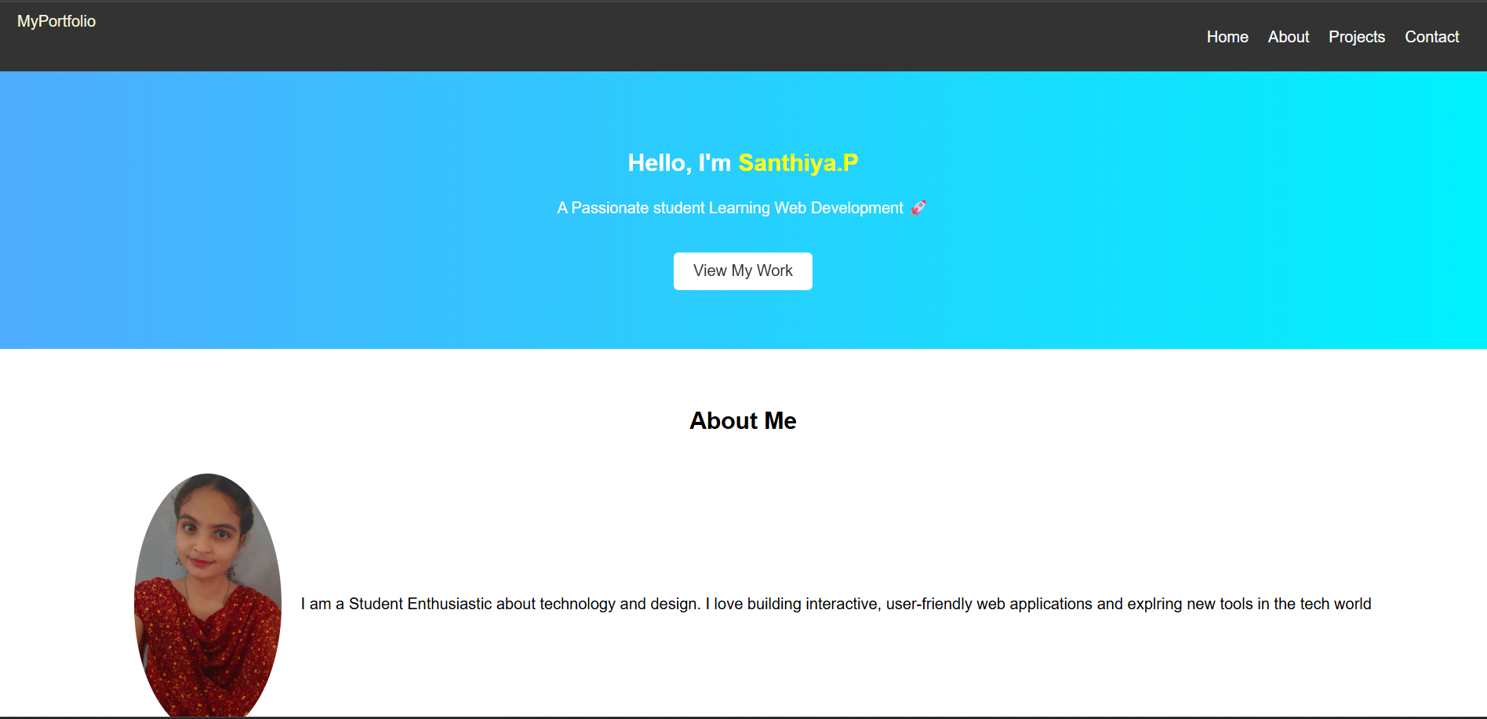
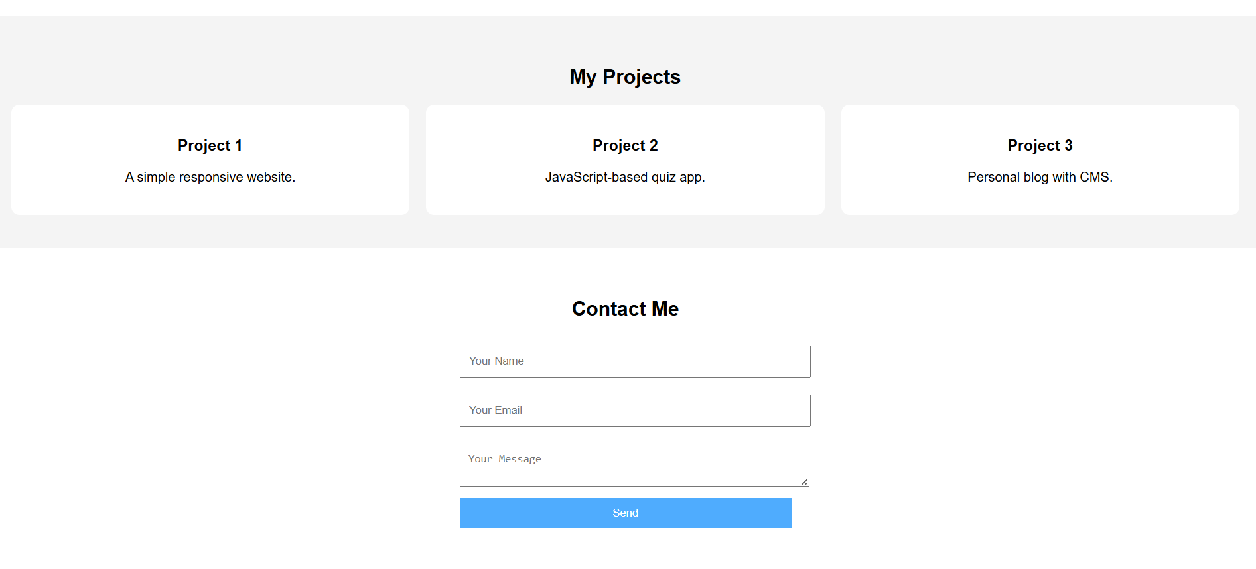
RESULTS AND SCREENSHOTS
3/21/2024 Annual Review
10

Slide 11
CONCLUSION
Digital Portfolio improves visibility.
Builds a personal brand.
Boosts career opportunities.
11

